Slide 1

ECE 2001 Basic Circuit Theory
Lecture 7
Sinusoidal Steady State Analysis

Slide 2
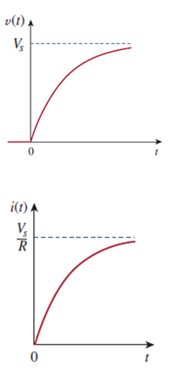
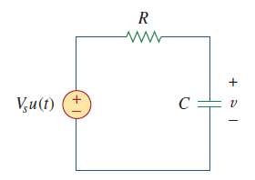
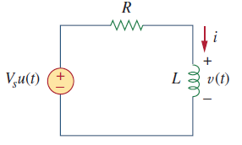
Review: First-order RC/RL Circuits
Find the initial value i(0) or v(0), calculate the steady state, determine the time constant, and get the solution:

Slide 3
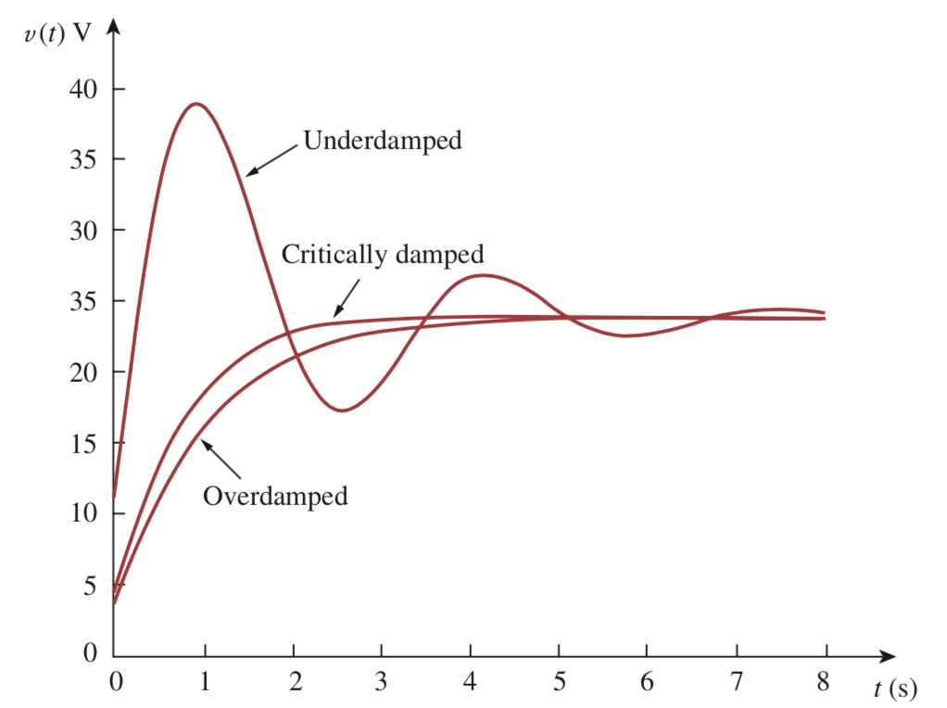
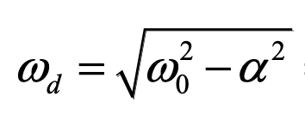
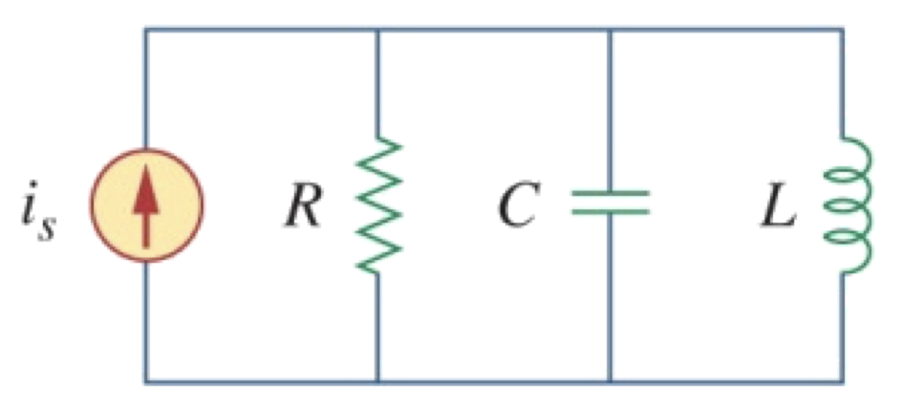
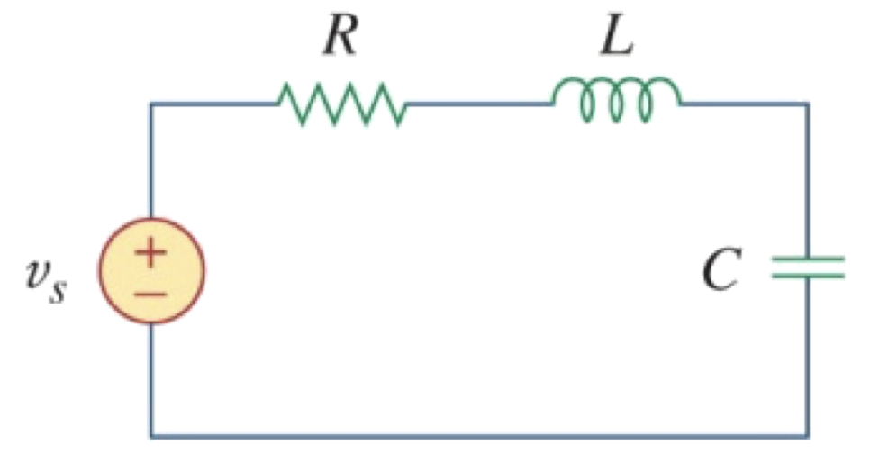
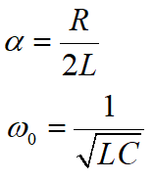
Review: Second-order RLC Circuits
Find initial values i(0), i’(0), calculate steady state, determine alpha and omega, identify a damping scenario for a general solution, specify the coefficient using initial conditions.

Slide 4
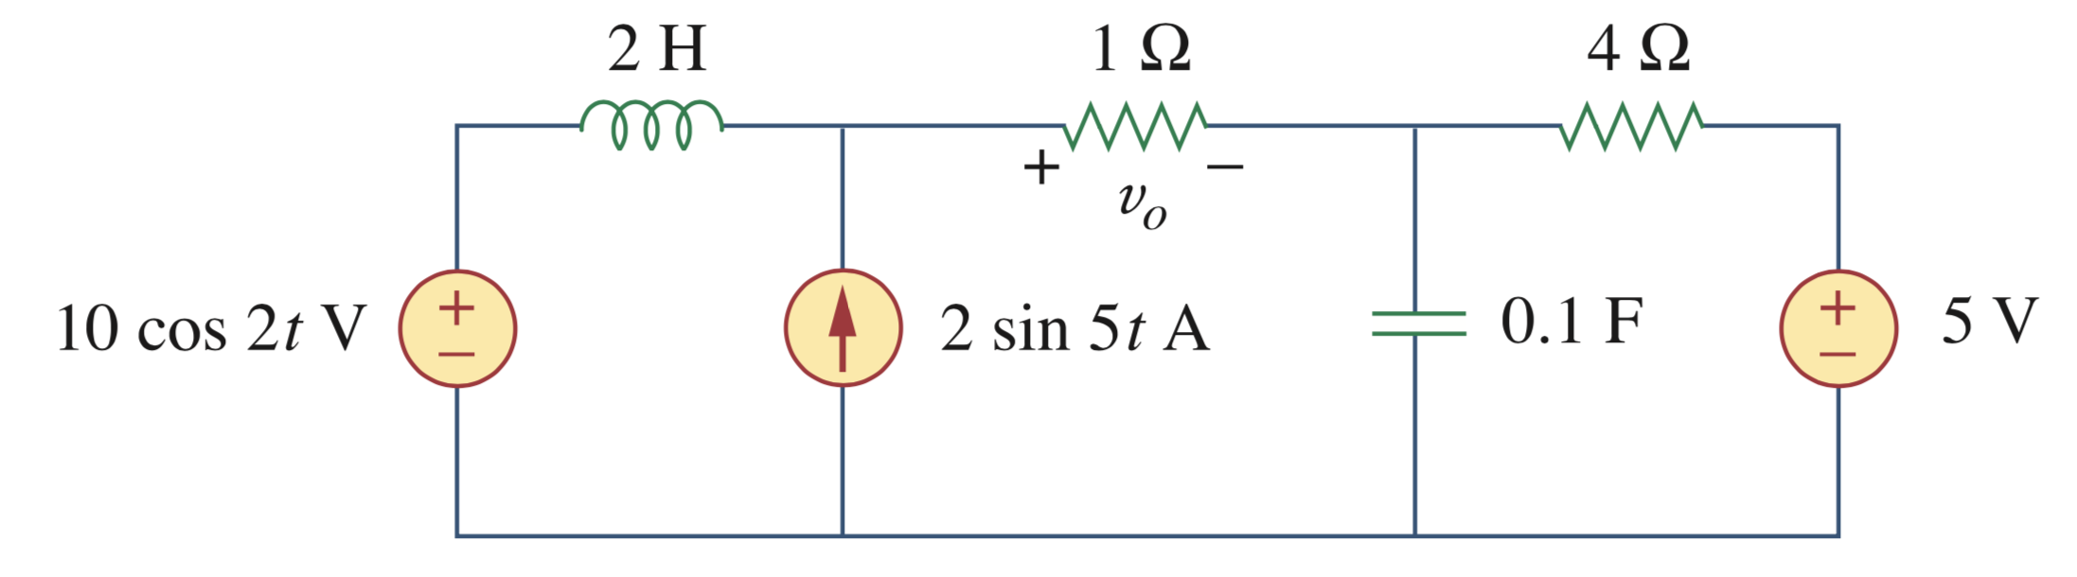
A motivational problem:
Assuming the circuit is in steady-state, how do we find v_{o}(t)?
“Standard” technique from last lectures: (1) Apply nodal analysis or mesh analysis to formulate 2nd-order ODEs, and (2) solve the 2nd-order ODE (could be very difficult).
What if we have more than 2 energy-storage elements?
Question: If we are only interested in the steady-state, do we have a better tool to find the solution without solving ODEs?

Slide 5
Overview
Phasor – simplified representation for sinusoidal signals
Impedance – a generalized concept of resistance to inductors and capacitors
Circuit analysis and circuit theorems for RLC circuits using concept of impedance

Slide 6
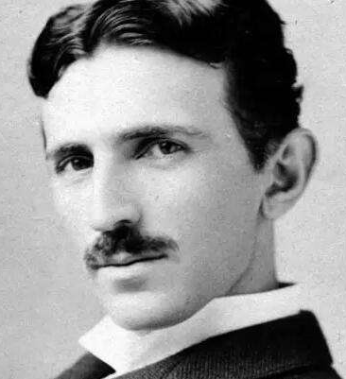

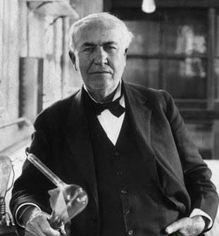
Alternating Current
Alternating Current, or AC, is the dominant form of electrical power that is delivered to homes and industry.
In the late 1800’s there was a battle between proponents of AC & DC.
AC won out due to its efficiency for long distance transmission.
AC is a sinusoidal current, meaning the current reverses at regular times and has alternating positive and negative values.
AC VS DC
Nikola Tesla
George Westinghouse
Thomas Edison

Slide 7
Sinusoids
A sinusoid is a signal that has the form of the sine or cosine function.
Sinusoids are interesting to us for a number of reasons:
  Many natural phenomenon are sinusoidal in nature: motion of a pendulum, vibration of a spring, ripples on the ocean surface etc.
  A sinusoidal signal is easy to generate and transmit, dominant form of signal in the communication and power industries.
  Through Fourier analysis, any practical periodic function can be represented by a sum of sinusoids.
  Lastly, a sinusoid is easy to handle mathematically; the derivative and integral of a sinusoid are also sinusoidal.

Slide 8
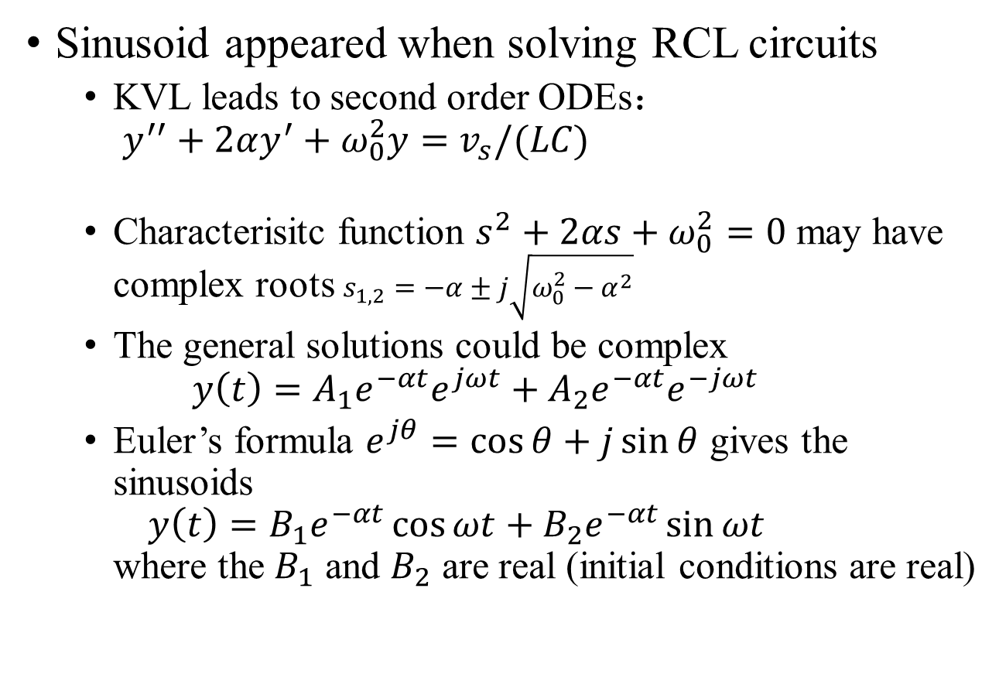
Background review: Why we run into sinusoids?
Sinusoid appeared when solving RCL circuits
  KVL leads to second order ODEs：
  $y^{′′}+2αy^{′}+ω_{0}^{2}y=$ $v_{s}/(LC)$
  Characterisitc function $s^{2}+2αs+ω_{0}^{2}=0$ may have complex roots $s_{1,2}=−α±j\sqrt{ω_{0}^{2}−α^{2}}$
  The general solutions could be complex
  $y\left(t\right)=A_{1}e^{−αt}e^{jωt}+A_{2}e^{−αt}e^{−jωt}$
  Euler’s formula $e^{jθ}=\cos{θ}+j\sin{θ}$ gives the sinusoids
  $y\left(t\right)=B_{1}e^{−αt}\cos{ωt}+B_{2}e^{−αt}\sin{ωt}$
  where the $B_{1}$ and $B_{2}$ are real (initial conditions are real)
Oscillations described by antenuatting sinusoids
Notes:
The implication:
RLC circuits ← (complex solution as a mathematical tool) → osciallation described by sinusoids

Slide 9
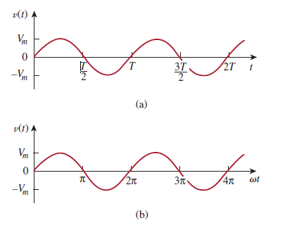
Sinusoidal Signal: the parameters
A sinusoidal voltage can be represented as:
where ωt is the argument; t, is time;
ω, the angular frequency in radian/s;
V_{m} is the amplitude (peak value);
T is the period;
From the two plots, we observe that

Slide 10
Sinusoidal Signal: the parameters
A sinusoidal voltage can be represented as:
The period is inversely related to another important characteristic, the frequency f
The units of frequency is cycles per second or Herts (Hz).
It is often referred in angular terms:
unit in radians per second (rad/s)

Slide 11
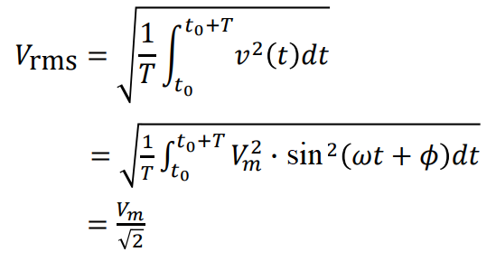
Sinusoidal Signal: the RMS Value
The root-mean-square (RMS) value of a periodic function is defined as the square root of the mean value of the squared function.
The RMS value of the sinusoidal signal depends only on the maximum amplitude, not a function of either the frequency or the phase angle.
It is important in calculating the power for the sinusoidal signal.

Slide 12
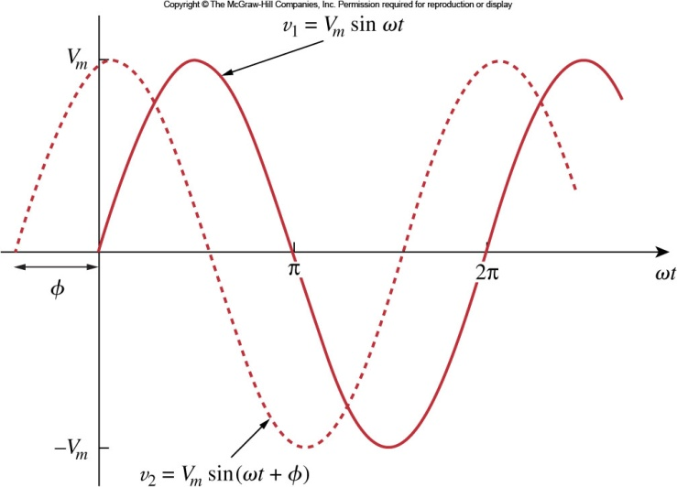
Leading or lagging
More generally, we need to account for relative timing of one wave versus another. This can be done by including a phase shift, φ. Consider the two sinusoids:
Positive phase shift φ: v₂ leads the v₁ by φ
Negative phase shift φ: v₂ lags the v₁ by |φ|
Out of phase: φ <> 0
In phase: φ = 0

Slide 13
Mathematical preparation I: sine to cosine
If two sinusoids are in phase, then this means that they reach their maximum and minimum at the same time.
Sinusoids may be expressed as sine or cosine. The conversion between them is:

Slide 14

Mathematical preparation II: Adding two sinusoids
Algebraic method
Remark: the sum can also be expressed as
e.g.

Slide 15
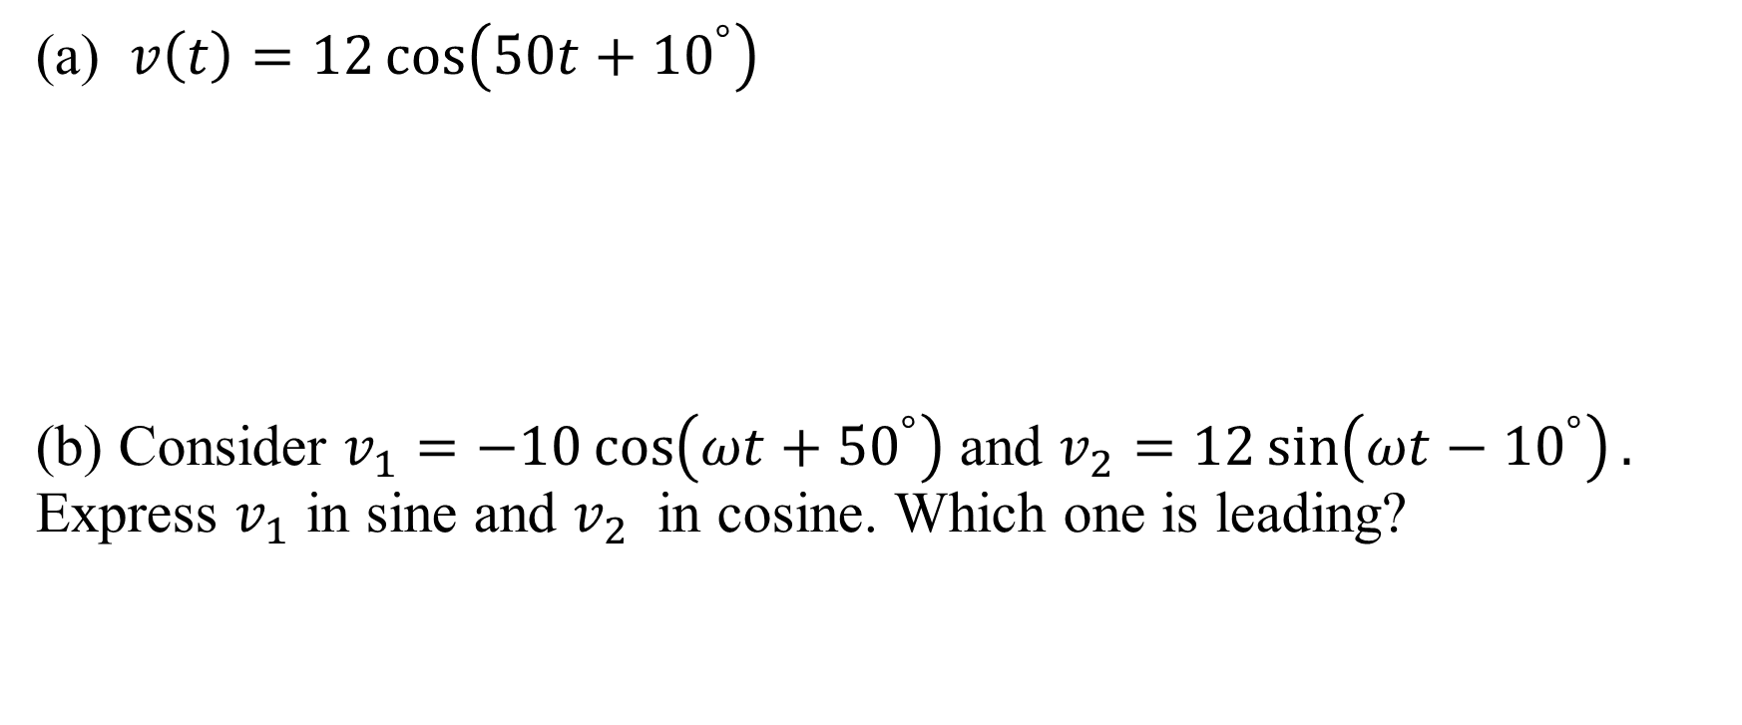
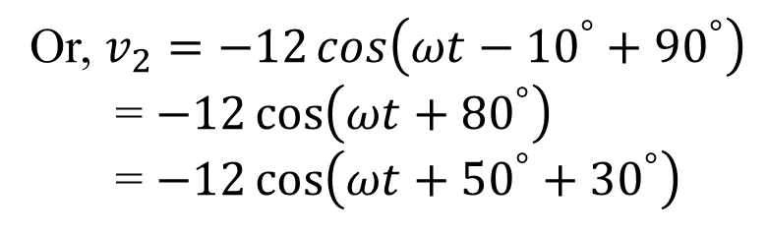
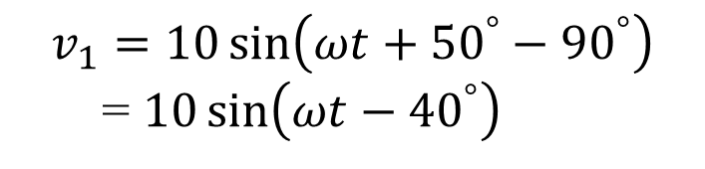
Practice
The amplitude is
The phase is
The angular frequency is
The period is
The frequency is
(a) $v\left(t\right)=12\cos\left(50t+{10}^{°}\right)$
(b) Consider $v_{1}=−10\cos\left(ωt+{50}^{°}\right)$ and $v_{2}=12\sin\left(ωt−{10}^{°}\right).$ Express $v_{1}$ in sine and $v_{2}$ in cosine. Which one is leading?
$$v_{1}=10\sin\left(ωt+{50}^{°}−{90}^{°}\right)$$
= $10\sin\left(ωt−{40}^{°}\right)$
Or, $v_{2}=−12\cos\left(ωt−{10}^{°}+{90}^{°}\right)$
= $−12\cos\left(ωt+{80}^{°}\right)$
= $−12\cos\left(ωt+{50}^{°}+{30}^{°}\right)$

Slide 16
Mathematical preparation III: Review of Complex Numbers
A powerful method for representing sinusoids is the phasor. But in order to understand how they work, we need to cover some complex numbers first.
A complex number z can be represented in rectangular form as:
where and x, y are real numbers.
It can also be written in polar or exponential form as:
where r≥0 and φ are again real numbers.

Slide 17
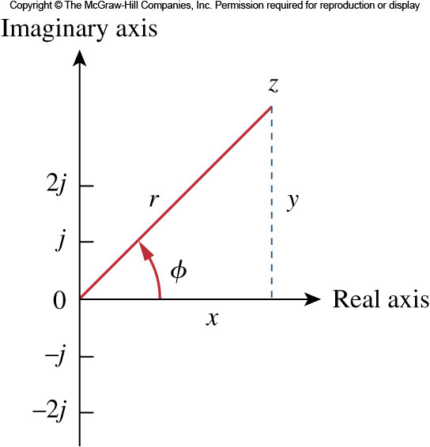
Complex Numbers
The different forms can be interconverted.
Starting with rectangular form, one can go to polar:
Likewise, from polar to rectangular form goes as follows:

Slide 18
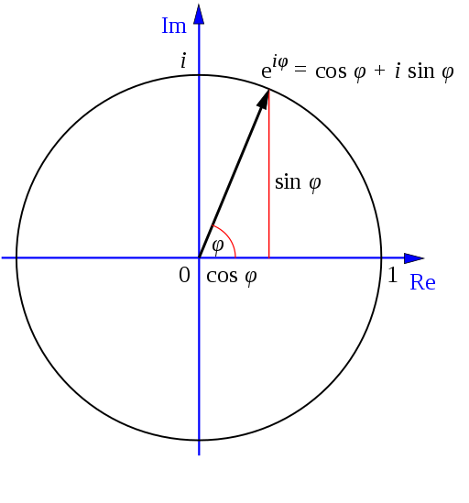
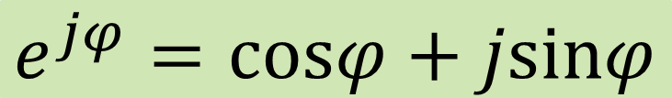

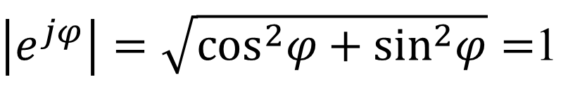
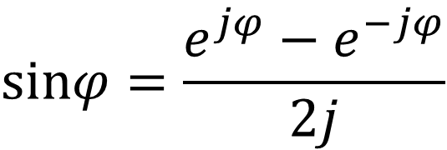
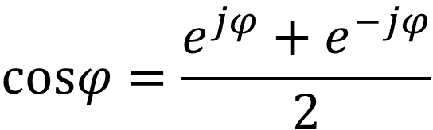
Euler’s Identity for complex numbers
$$e^{jφ}=\text{cos}φ+j\text{sin}φ$$
$\left|e^{jφ}\right|=\sqrt{{\text{cos}}^{2}φ+{\text{sin}}^{2}φ}=$1
1 = ?
j = ?
$$\text{cos}φ=\frac{e^{jφ}+e^{−jφ}}{2}$$
Therefore, complex number can also be written in exponential form rather than polar form:
$$\text{s}inφ=\frac{e^{jφ}−e^{−jφ}}{2j}$$
$$Z=\left|Z\right|e^{jφ}=ze^{jφ}=z∠φ$$

Slide 19
Complex Numbers
The following mathematical operations are important
Addition
Subtraction
Multiplication
Division
Reciprocal
Square Root
Complex Conjugate
Note: other than +/-, arithmetic operations of complex numbers are more conveniently expressed in polar form

Slide 20
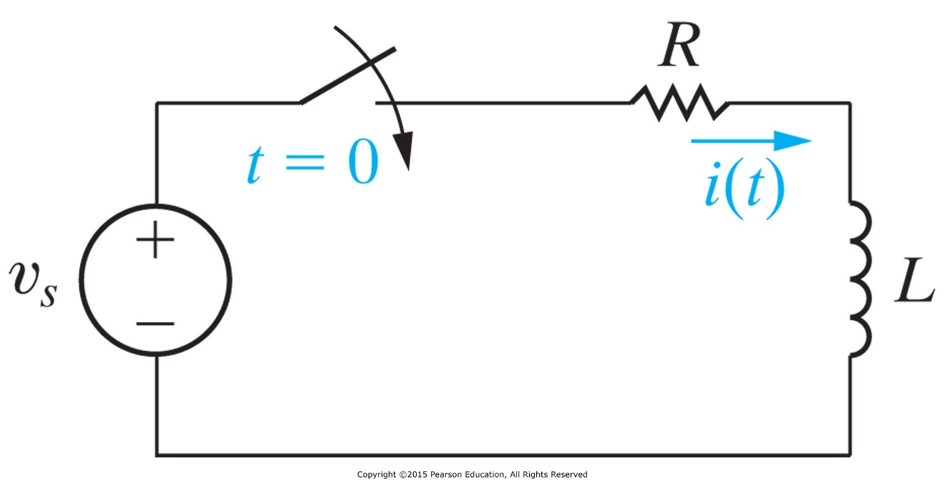



* The Sinusoidal Response
Find i(t), for t ≥ 0.
First order RL circuit
Time constant τ = ?
where θ is defined as the angle whose tangent is ωL/R.
Remark: Deriving the solution requires solving an inhomogeneous ODE (where the righthand-side is a general function), which is not required by this course. So just take this solution for granted.

Slide 21
The Sinusoidal Response: A more general concept of steady state response
The response contains
  a transient response
  a steady state response
When the transient has died out, we say the circuit is in sinusoidal steady state.
  The steady-state solution is sinusoidal
  The frequency of the response signal is identical to that of the source signal (otherwise there is nonlinear element in the circuit)
  Magnitude and phase of the response differs from those of source signal.

Slide 22
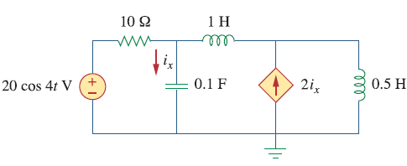

It is sufficient to use amplitude and phase to describe a circuit in steady state
Consider sinusoidal sources
Linear elements change amplitude and phase, but not the frequency
Cosine and sine can all be converted to cosine (with appropriate phase shifts) with the same frequency
As a result, every current and voltage can be written in cosine form:
Vary at different nodes or branches
$$Acos\left(ωt+φ\right)$$
Common factor in the circuit

Slide 23
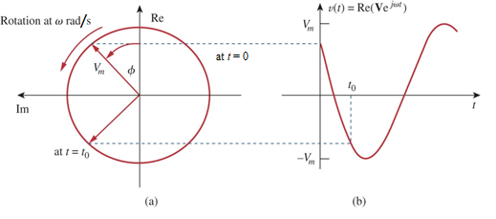
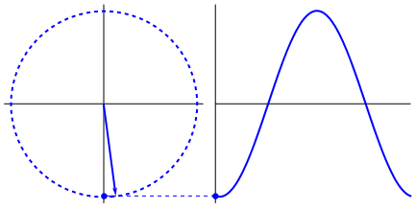

Phasors Representation: Use a vector in the complex plane to represent a sinusoid (for a given frequency)
The idea of a phasor representation is based on Euler’s identity:
Re() and Im() stand for the real part of and the imaginary part of.
We may regard the function v(t) as the projection of ${Ve}^{jωt}$ on the real axis.
$$v\left(t\right)=V_{m}cos\left(ωt+φ\right)=Re(V_{m}e^{jφ}e^{jωt})$$

Slide 24
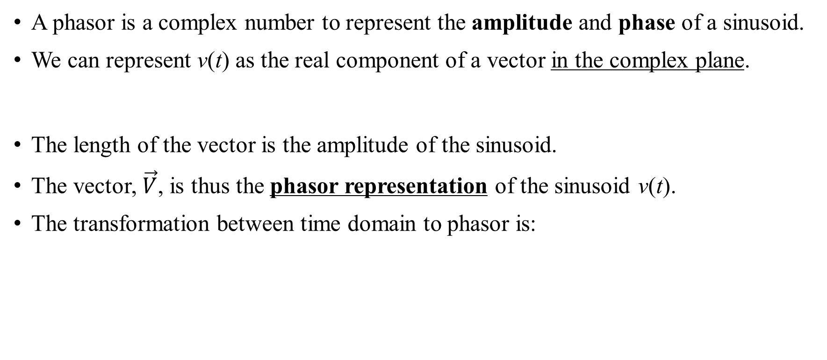
Phasors
A phasor is a complex number to represent the amplitude and phase of a sinusoid.
We can represent v(t) as the real component of a vector in the complex plane.
The length of the vector is the amplitude of the sinusoid.
The vector, $\vec{V}$, is thus the phasor representation of the sinusoid v(t).
The transformation between time domain to phasor is:
Attention: You need to change the sinusoidals to the standard form:
i) cosine, ii) Vm is positive.

Slide 25
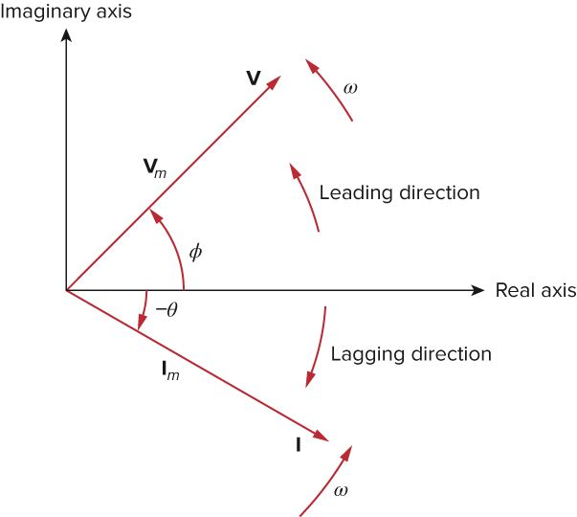
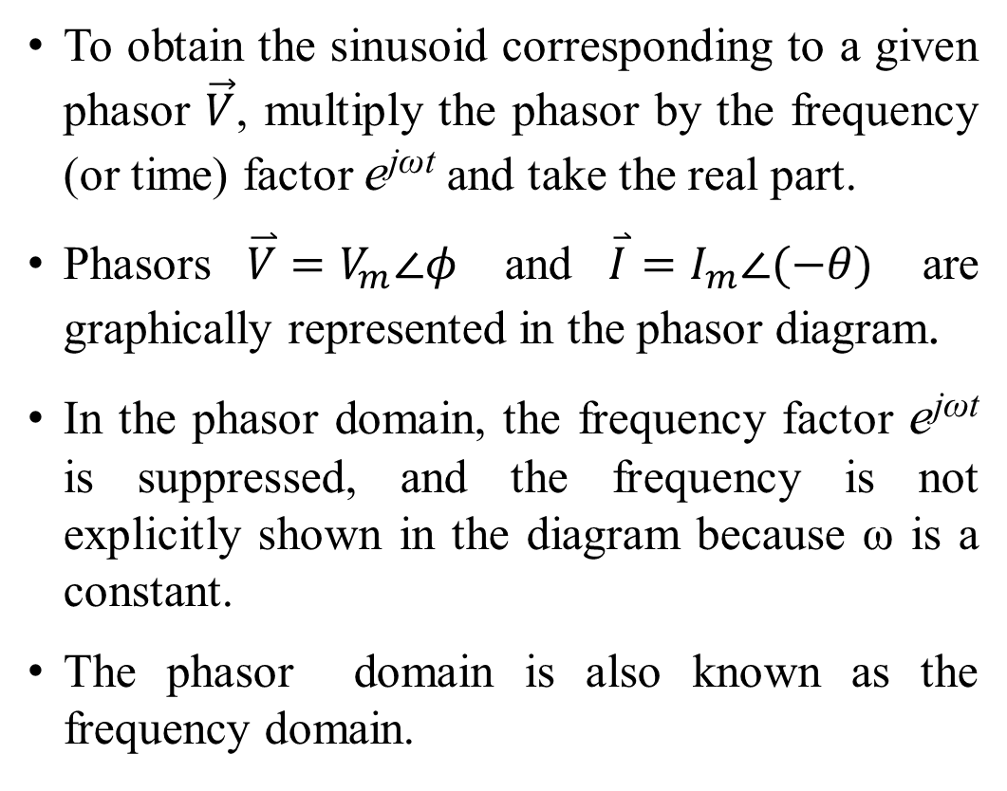
Phasor diagram
To obtain the sinusoid corresponding to a given phasor $\vec{V}$, multiply the phasor by the frequency (or time) factor e^{jωt} and take the real part.
Phasors $\overset{⃑}{V}=V_{m}∠φ$ and $\overset{⃑}{I}=I_{m}∠(−θ)$ are graphically represented in the phasor diagram.
In the phasor domain, the frequency factor e^{jωt} is suppressed, and the frequency is not explicitly shown in the diagram because ω is a constant.
The phasor domain is also known as the frequency domain.

Slide 26
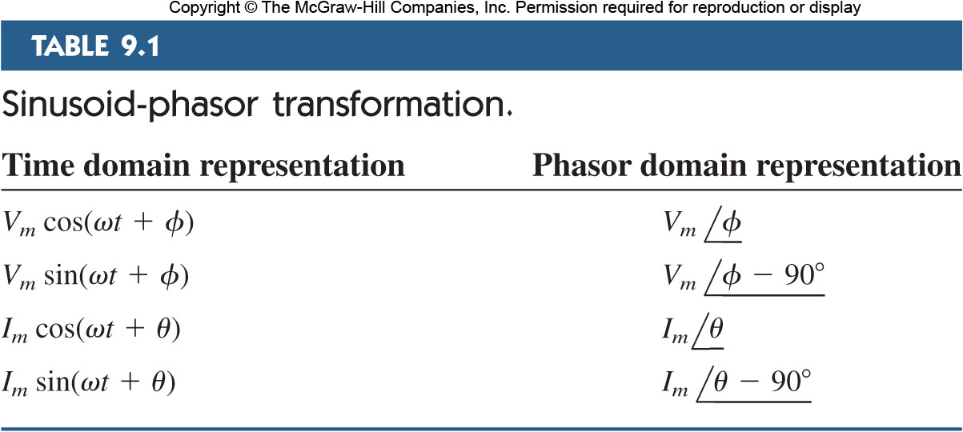
Sinusoid-Phasor Transformation
Here is a handy table for transforming various time domain sinusoids into phasor domain:

Slide 27

Sinusoid (time domain) – Phasor (frequency domain) Transformation for derivative and integral
Given
The derivative is transformed to the phasor domain as:
Similarly, the integral is transformed to the phasor domain as:
$$v\left(t\right)=V_{m}cos\left(ωt+φ\right)$$

Slide 28

Example 1
Transform these sinusoids to phasors:
$i=6cos⁡(50t−{40}^{∘})$ A
$v=−4sin⁡(30t+{50}^{∘})$ V
$i=−4sin⁡(10t+{100}^{∘})$ A
$v=7cos⁡(2t+{40}^{∘})$ V

Slide 29

Example 2
Find the sinusoids represented by these phasors:
$\vec{I}=−\frac{1}{2}+\frac{\sqrt{3}}{2}j$ A
$\vec{V}=j8e^{−j{20}^{∘}}$ V
$\vec{V}=−25∠{40}^{∘}$

Slide 30








Example 3
Given $i_{1}(t)=4cos⁡(ωt+{30}^{∘})$ A and $i_{2}(t)=5sin⁡(ωt−{20}^{∘})$ A, find their sum.

Slide 31
Example 4
Using the phasor approach, determine the “steady state” current i(t) in a circuit described by the integro-differential equation:
Obtain the phasor form of the equation:
As ,
Converting to the time domain:
Note: This is ONLY the steady-state solution, and it does not require knowledge of the initial values.

Slide 32
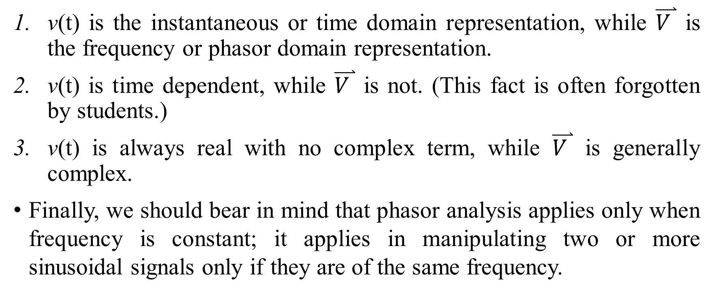

Differences between v(t) and $\overset{⃑}{V }$
v(t) is the instantaneous or time domain representation, while $\overset{⃑}{V }$ is the frequency or phasor domain representation.
v(t) is time dependent, while $\overset{⃑}{V }$ is not. (This fact is often forgotten by students.)
v(t) is always real with no complex term, while $\overset{⃑}{V }$ is generally complex.
Finally, we should bear in mind that phasor analysis applies only when frequency is constant; it applies in manipulating two or more sinusoidal signals only if they are of the same frequency.

Slide 33
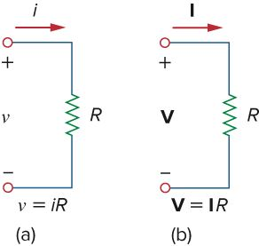
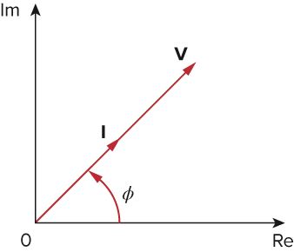
Phasor Relationships for Resistors
Each circuit element has a relationship between its current and voltage.
These can be mapped into phasor relationships very simply for resistors, capacitors and inductor.
For the resistor, the voltage and current are related via Ohm’s law.
As such, the voltage and current are in phase with each other.
If the current through R is
the voltage across it is
The phasor form of Ohm’s law:

Slide 34
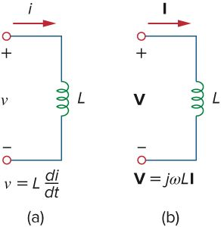
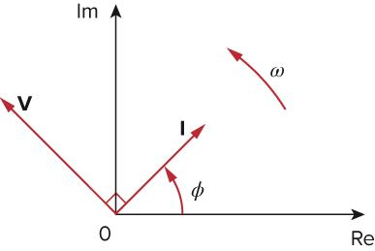
Phasor Relationships for Inductors
For inductors,
Transform to phasor
Since ，
Inductors have a phase shift between the voltage and current.
The current lags the voltage by 90º.
This is represented on the phasor diagram by a positive phase angle between the voltage and current.

Slide 35
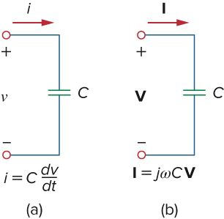


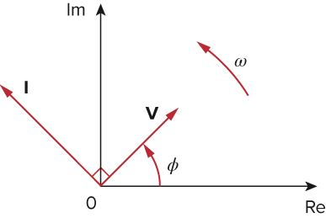

Phasor Relationships for Capacitors
For capacitors
Capacitors have the opposite phase relationship as compared to inductors.
The current leads the voltage by 90º.
In a phasor diagram, this corresponds to a negative phase angle between the voltage and current.
$$\vec{V}=\frac{\vec{I}}{jωC}$$

Slide 36
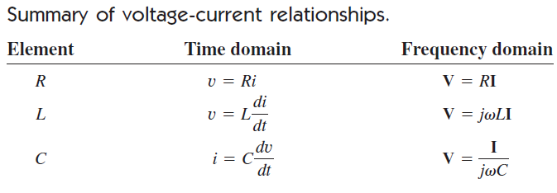

Slide 37
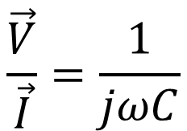
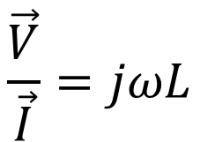
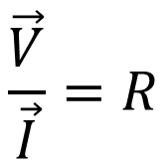
Impedance
Using the representation of phasor, it is possible to expand Ohm’s law to capacitors and inductors. The voltage-current relationship equations may be written in terms of the ratio of phasor voltage and current.
$$\frac{\vec{V}}{\vec{I}}=R$$
$$\frac{\vec{V}}{\vec{I}}=jωL$$
$$\frac{\vec{V}}{\vec{I}}=\frac{1}{jωC}$$
The impedance of a circuit element is the ratio of the phasor voltage to the phasor current.
Impedance is not a phasor, its unit is Ohm (Ω).
Impedance is frequency dependent.

Slide 38
Admittance
Just like the relationship between Resistance and Conductance, we introduce a property as the inverse of impedance – admittance.
The admittance is simply defined as the inverse of impedance, units in Siemens or mhos (S or ) is simply the inverse of impedance.
  Both Z and Y are complex numbers.
  Admittance is also frequency dependent.
Ω

Slide 39
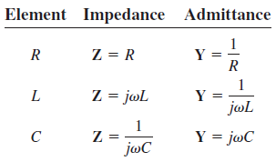
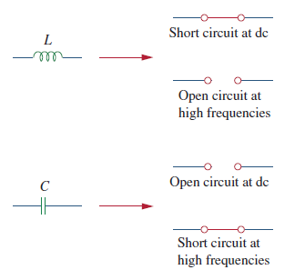
Impedance and Admittance
It is important to realize that in frequency domain, the values obtained for impedance are only valid at that frequency.
Changing to a new frequency will require recalculating the values.
At low frequencies (ω→0),
capacitor is open and inductor is short circuit!
At high frequencies (ω→∞),
capacitor is short and inductor is open circuit!

Slide 40
Impedance
As a complex quantity, the impedance may be expressed in rectangular form.
It may also be expressed in polar form as:
When the angle is positive, we say the impedance is inductive, and capacitive when it is negative.
The imaginary part is called the Reactance
The real part is called the Resistance
Both in units of Ohms

Slide 41
Admittance
Similarly, admittance being the reciprocal of the impedance, is also a complex number.
The real part of the admittance is called the Conductance, G. The imaginary part is called the Susceptance, B.
The impedance and admittance components can be related to each other:
Both in units of Siemens

Slide 42
Kirchoff’s Laws in Frequency Domain
A powerful aspect of phasors is that Kirchhoff's laws apply to them as well.
This means that a circuit transformed to frequency domain can be evaluated by the same methodology developed for KVL and KCL, only that there will likely be complex values.
Let v_{i} let be the i^{th} voltages around a closed loop containing n elements.
Writing in phasor form
Similarly, at any node , where is the phasor current of the i^{th} branch.
Sinusoid Steady-State

Slide 43


Impedance Combinations
Series combinations will result in a sum of the
impedance elements:
Here then two elements in series can act like
a voltage divider
Likewise, elements combined in parallel will combine in the same
fashion as resistors in parallel:
Expressed as admittance, though, they are again a sum:
As a current divider:

Slide 44
Impedance Combinations
The Delta-Wye transformation is:
A Δ or Y circuit is said to be balanced if it has equal impedances in all three branches.
When a Δ-Y circuit is balanced,

Slide 45


Example 5
The voltage v = 12cos(60t + 45º.) is applied to a 0.1-H inductor. Find the steady-state current through the inductor.
For an inductor
Phasor domain calculations:
Converting to the time domain:

Slide 46

Example 6
Find the input impedance of the circuit, which operates at ω=50 rad/s.
The input impendence is thus
which is equivalent to a resistor 3.22 Ω in series with a capacitor (11.07x50)⁻¹F.

Slide 47


Example 7
Determine v_{o}(t) in the circuit.
Transform to the frequency domain
From the frequency domain circuit
Thus
Time domain circuit
Same circuit in frequency domain

Slide 48
Example 8
Find i(t) and v(t) in the circuit shown.
For the source:
The impedance of two elements together as one is
Thus the current in the phasor domain is
The voltage across C is
in the time domain:
Note: i leads v by 90º as it should for a C, but v lags behind v_{s} by 63.43º=tan⁻¹|X/R|.

Slide 49



Application Example – RC Phase shifter
Total impedance
leads by an angle
In circuit (a), , which is taken across R, leads .
The phase shift is determined by the value of RC, but is always less than 90º.
Note: Phase shifter can also be achieved with R & L.
$$θ=\tan^{−1}\left|\frac{X_{C}}{R}\right|$$

Slide 50


Application Example – Cascaded Phase Shifter
We should keep in mind the simple RC phase shifter also acts as voltage divider.
Thus, only use when small amounts of phase shift are required. (less than 60。)
To get large phase shifts, several stages of RC shifter may be cascaded.
e.g. For the circuit on the right
And
Phase shift of each stage could be different.
Succeeding stage loads down the earlier stage
and complicates circuit design.
Use op-amp to isolate the stages and boost the signal.

Slide 51

Steps to Analyze an AC Circuit
There are three steps to analyzing an AC circuit.
  Transform the circuit to the phasor or frequency domain.
  Solve the problem using circuit techniques (same as DC).
  Transform back to time domain.

Slide 52
Nodal Analysis: Everything is the same as in DC case, except that impedance and phasors in complex values are used
It is possible to use KCL to analyze a circuit in frequency domain.
The first step is to convert a time domain circuit to frequency domain by calculating the impedances of the circuit elements at the operating frequency.
Note that sinusoidal sources appear as DC sources with their values expressed as their phasors.
Impedances will be expressed as complex numbers; sources will have amplitude and phase noted.
At this point, KCL analysis can proceed as normal.
It is important to bear in mind that complex values will be calculated, but all other treatments are the same.

Slide 53

Example 9
Find i_{x} using nodal analysis
Angular frequency ω=4 rad/s, transform all elements in phasor domain.
KCL at node 1 of the frequency domain circuit,
At node 2, . Since
Sub and simply:

Slide 54
Example (cont’d)
(Adjoint matrix)^transpose
In matrix form
Hence
The current
In time domain

Slide 55
Nodal Analysis II
The final voltages and currents are transformed from the phasor representations.
The equivalency of the frequency domain treatment compared to the DC circuit analysis includes the use of supernodes.

Slide 56


Mesh Analysis
Just as in KCL, the KVL analysis also applies to phasor and frequency domain circuits. In KVL, supermesh analysis is also valid.

Slide 57



Superposition
Since AC circuits are linear, it is also possible to apply the principle of superposition.

Slide 58


Sources with Different Frequencies
This becomes particularly important when the circuit has sources operating at different frequencies.

Slide 59
Sources with Different Frequencies
This becomes particularly important when the circuit has sources operating at different frequencies.
  The complication is that each source MUST have its own frequency domain equivalent circuit. The reason for this is that each element has a different impedance at different frequencies.
  Also, the resulting voltages and current must be converted back to time domain before being added. This is because there is an exponential factor e^{jωt} implicit in sinusoidal analysis.

Slide 60



Example 10
Find v_{o}.
For the 5V DC source alone, consider (a).
For cos2t source alone, consider (b)
Let Z be the equivalent impedance for the parallel elements
ω=0 rad/s
ω=2 rad/s

Slide 61

Example (cont’d)
For the sin5t source alone, consider (c)
note: different values from the same forms.
ω=5 rad/s
All three sources together

Slide 62

Source Transformation
Source transformation in frequency domain involves transforming a voltage source in series with an impedance to a current source in parallel with an impedance.
Or vice versa:

Slide 63

Thévenin and Norton Equivalency
Both Thévenin and Norton’s theorems are applied to AC circuits the same way as DC. The only difference is the fact that the calculated values will be complex.
Remark: The 2 complex quantities have 4 real parameters. Actually 3 out of 4: magnitudes of V_{Th} and Z_{Th} and their relative phase, are often sufficient. The absolute phase can be absorbed into the definition of t.

Slide 64

Example 11
Find the Thévenin equivalent of the circuit.
Note: the circuit is labelled by phasors.
Apply KCL at node 1 in (a),
Applying KVL to the loop on the r. h. s.
To find Z_{th}, apply to (b). Note: 3 is arbitrary.
By KCL:
By KVL:
So
$$15∠0^{o}−{\overset{⃑}{I}}_{o}−0.5{\overset{⃑}{I}}_{o}=0→{\overset{⃑}{I}}_{o}=10∠0^{o}A$$

Slide 65


Op Amp AC Circuits
As long as the op amp is working in the linear range, frequency domain analysis can proceed just as it does for other circuits.
It is important to keep in mind the two qualities of an ideal op amp:
  No current enters either input terminals.
  The voltage across its input terminals is zero with negative feedback.
An additional implicit assumption: the ideal op amp has infinite bandwidth—its behavior does not depend on frequency ω.
$$i_{+}=i_{−}=0$$
$$v_{+}=v_{−}$$

Slide 66
* Application Example – Capacitor Multiplier: A circuit to increase the capacitance
It is used in integrated circuit technology to create large capacitances out of smaller ones (Large C tends to be bulky, while ICs can be made small).
The first op amp is acting as a voltage follower, while the second one is an inverting amplifier.
At node 1:
Applying KCL at node 2 gives
Combining
Notes:
* This page and the following pages are optional.

Slide 67
* Capacitor Multiplier II
This is the input impedance seen between the terminal and ground,
.
By selecting the resistors, the circuit can produce an effective capacitance between its terminal and ground.
Limitation of the circuit using real op-amps:
  The larger the multiplication factor, the easier it is for the inverting stage to go out of the linear range.
  Thus the larger the multiplier, the smaller the allowable input voltage.

Slide 68
Expected learning outcome
Be able to derive the phasor representation for sinusoidal circuits
Be able to calculate impedance for RLC circuits using arithmetic operations on complex numbers (addition, subtraction, multiplication, division, differentiation and integration)
Be able to extend the circuit analysis techniques (nodal analysis, mesh analysis) and circuit theorems (Thevénin theorem, source transformation, and superposition principle) to sinusoidal RLC circuits and perform circuit analysis

